Slide 1



Designing Responsive Movie Website – Presenting Movie Data with AJAX
Marija Stojcheva 201520

Slide 2
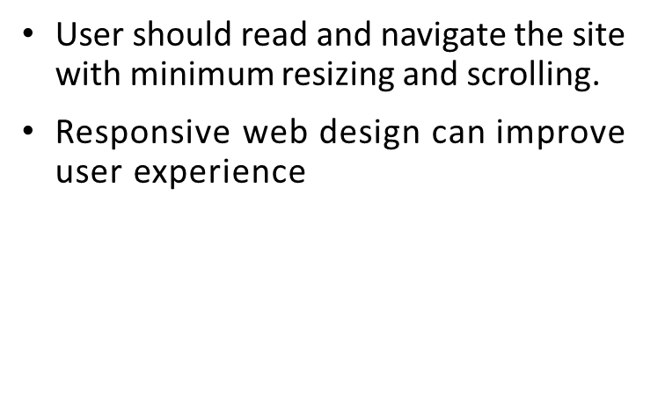
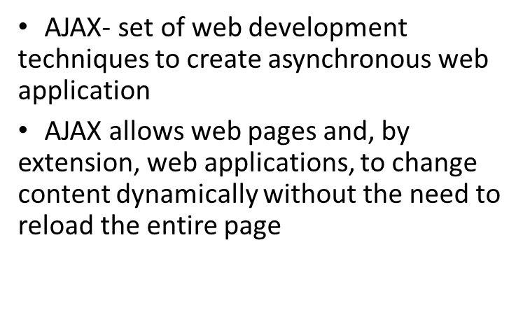
Designing Responsive Website with AJAX

Slide 3
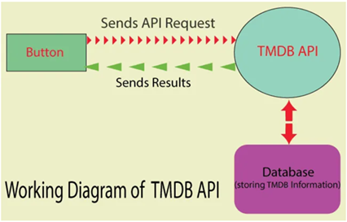
API: Application Programming Interface
The server then retrieves that data, interprets it, performs the necessary actions, and sends it back.
The application then interprets that data and presents the needed information in a readable way.
When an application is used, it connects to the Internet and sends data to a server.

Slide 4
How I designed my Responsive Site with AJAX
TheMovieDB API as source for the needed information about the movies
API key is needed
This API provides details about many movies,TV shows and actors
Free of charge
Integrated by using jQuery AJAX- fast, small, and feature-rich JavaScript library which makes the document easy to use across a multitude of browsers
Responsive by using Bootstrap libraries

Slide 5
The Concept of my Website
A well-designed movie website can be extremely helpful, since you can easily find movies that match your interests based on some criteria.
On my site users can search the movies by title, genre or actors.
Title, genres, release date, short plot, actors, user score and teaser about each movie or TV show are displayed, as well as short bios for the actors.

Slide 6
HTML Page Code Description and CSS
The HTML Page contains a menu, input text box and a button.
User enters the movie/TV show/actor name in the text box and presses the button
Genre on-click drop down list
Empty <div> tags, afterwards the information obtained for the movies are shown
Close buttons for the <div> tags
I used CSS to obtain the wanted design of the website.

Slide 7
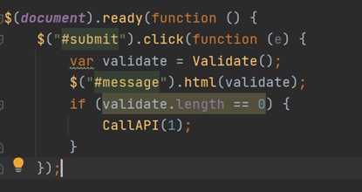
jQuery AJAX to call TheMovieDB API
A page can't be manipulated safely until the document is "ready." jQuery detects this state of readiness.
Validate () checks whether the selected form is valid or whether all selected elements are valid.
On the button click the CallAPI() method is called. This method makes the jQuery AJAX call to the TMDB API

Slide 8
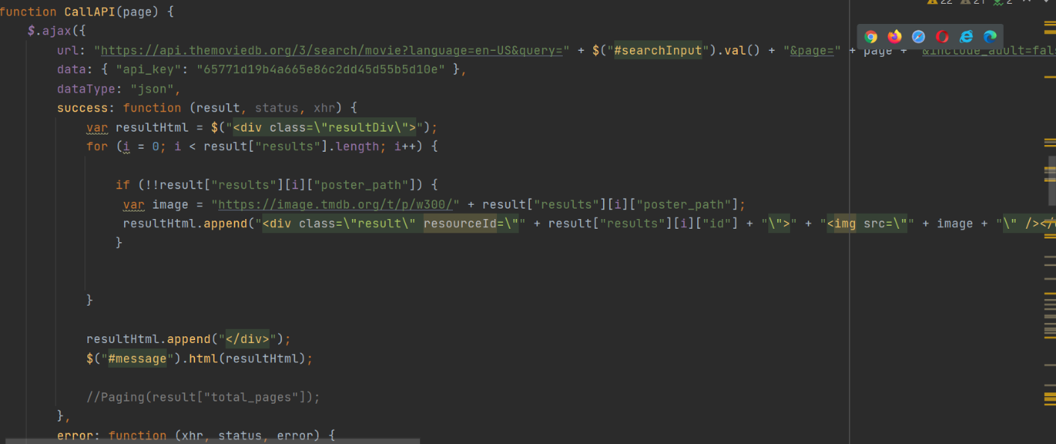

Slide 9
Movie jQuery and Results
Parameters in a URL path
Dynamically inserted parametars, api_key, json datatype
Success(result,status,xhr): looping through the JSON result and extracting values from it
ResourceId attribute: ids of the results of the success function
These ids are used to make another jQuery AJAX request to fetch the complete information for that id.

Slide 10
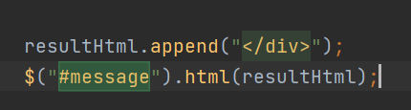
If the request was successful after entering the movie title or actor name, with the append() method that inserts specified content at the end of the selected elements, the posters of movies and actors that satisfy the criteria are shown on the screen.

Slide 11
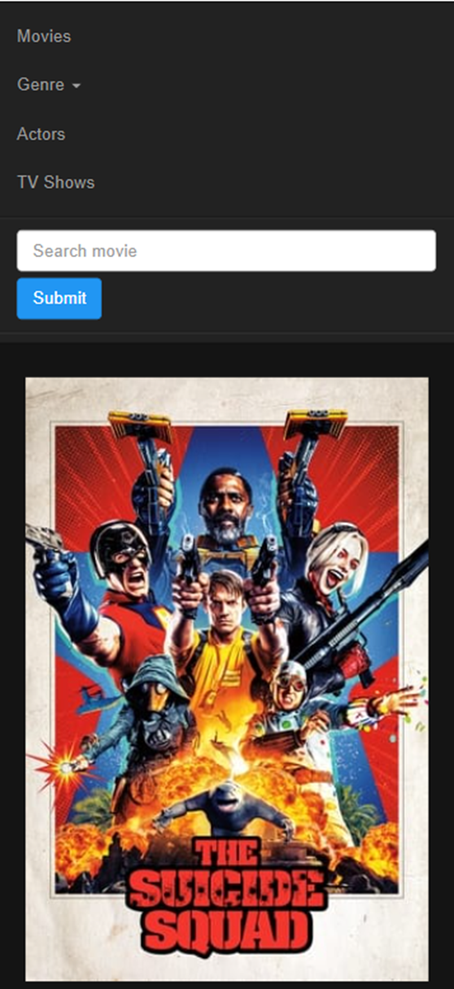
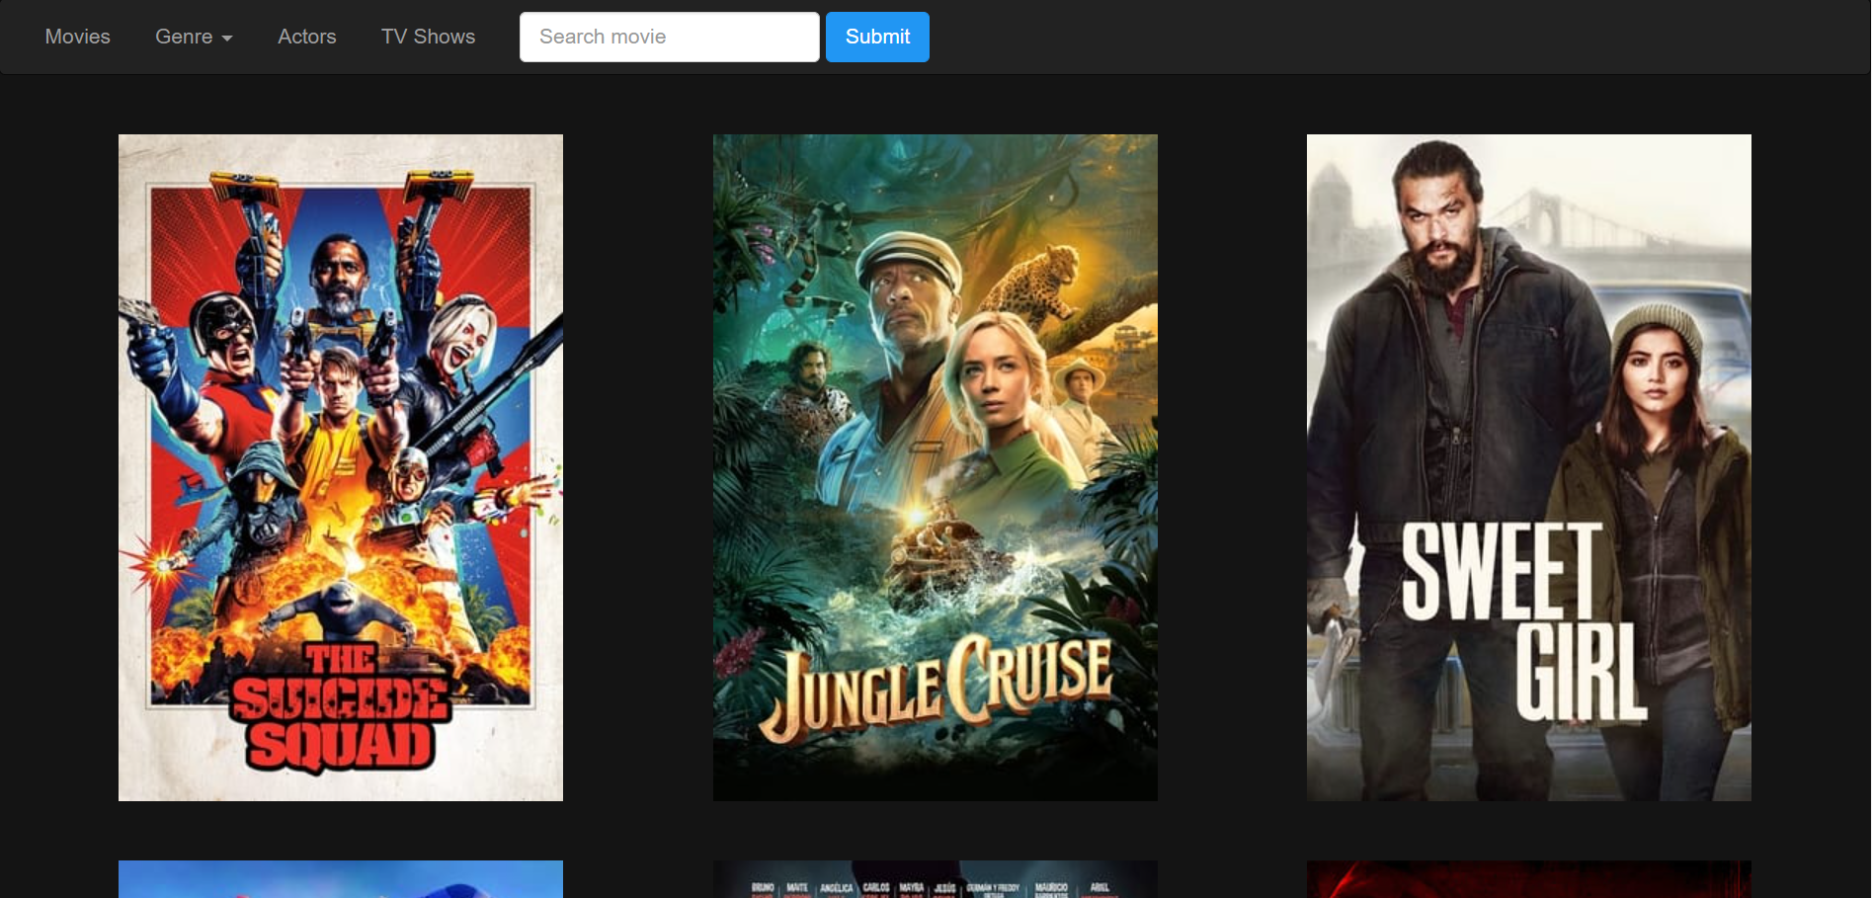

Slide 12
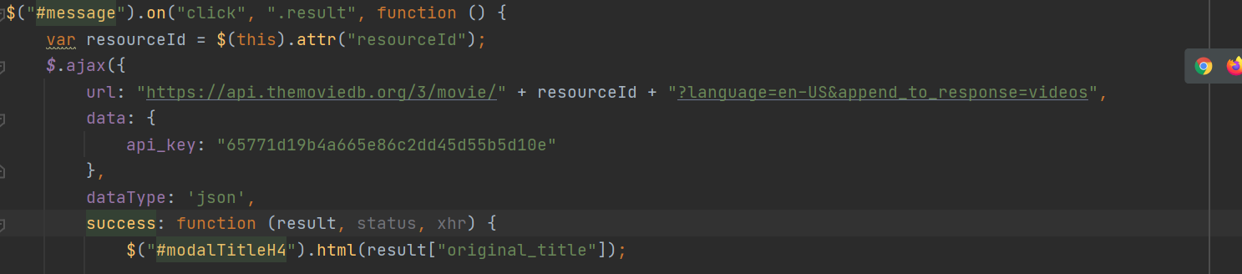
Details about the Movies
When the API gives the results back and posters are shown, a functionality should be added so that on clicking any movie’s picture, the API will give us details about it.
Bootstrap Modal is created and another API call is made
With the resourceId previously obtained and the api_key, I form the url and search the data that I need in the data base.

Slide 13
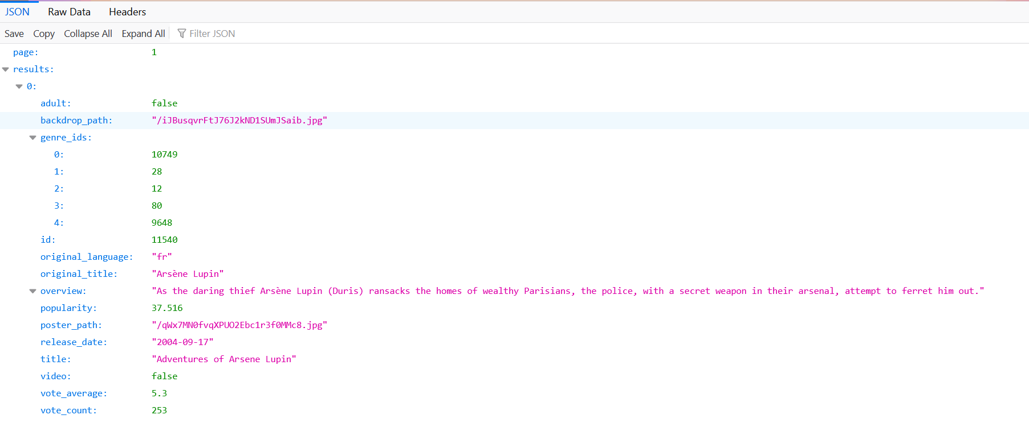

Slide 14



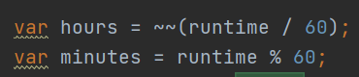
Information used from the Data Base
Release date (only the year)
Vote Average
Run-time in format (h) : (min)
Original title
Overview
Trailer
Genres
Poster Path

Slide 15
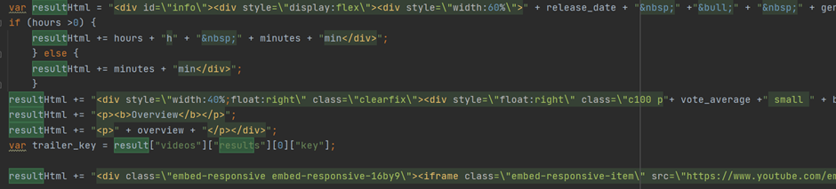
Ternary operator- for the unavailable, appropriate message to be shown.
All information are added to the header of the empty <div> tag
Obtained data is put in body of the <div> and styled
Overview and a short trailer for each of the movies in the body
With url from the data base and <iframe>, video from YouTube for each movie appears.

Slide 16
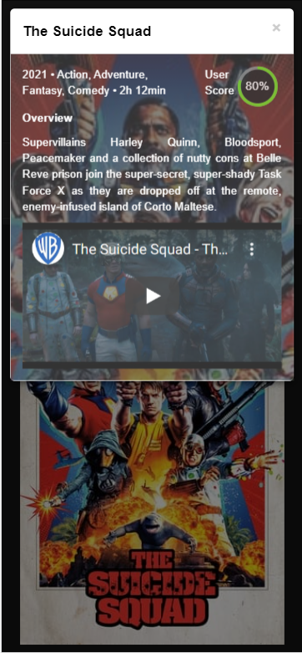
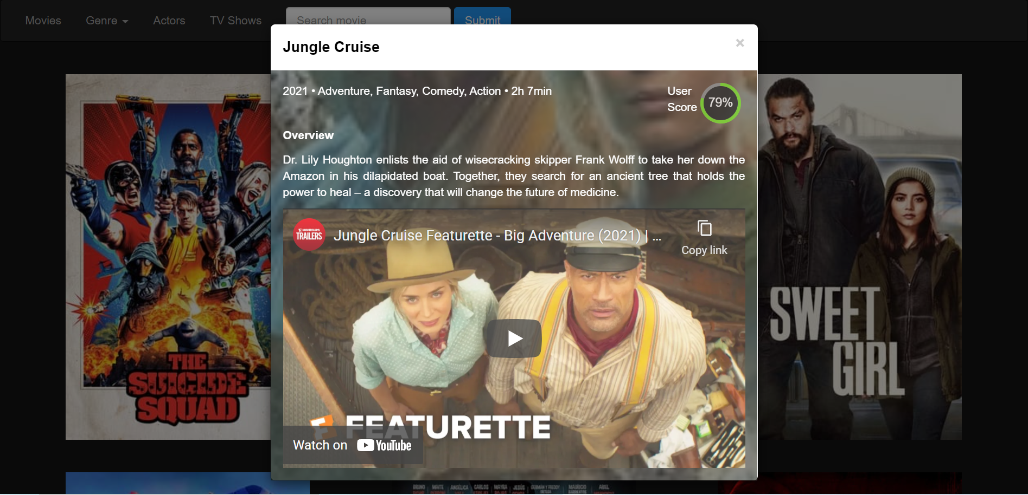

Slide 17
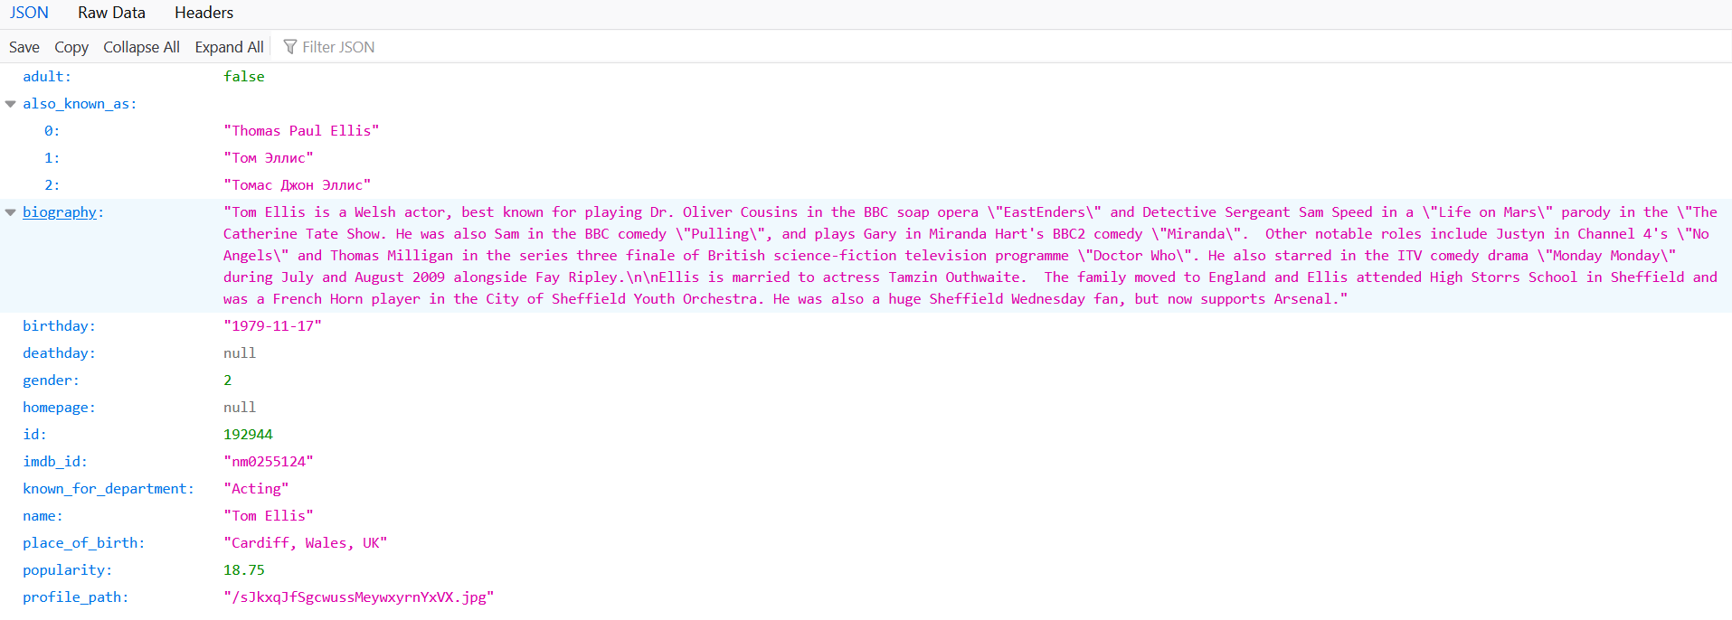
Actors jQuery and Results
The information about the actors are obtained similarly as for the movies.
From information I get for each of the actors, and I extract the name, the photo and a short biography.

Slide 18
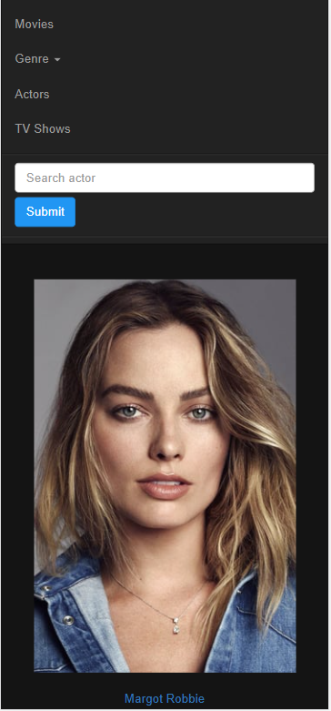
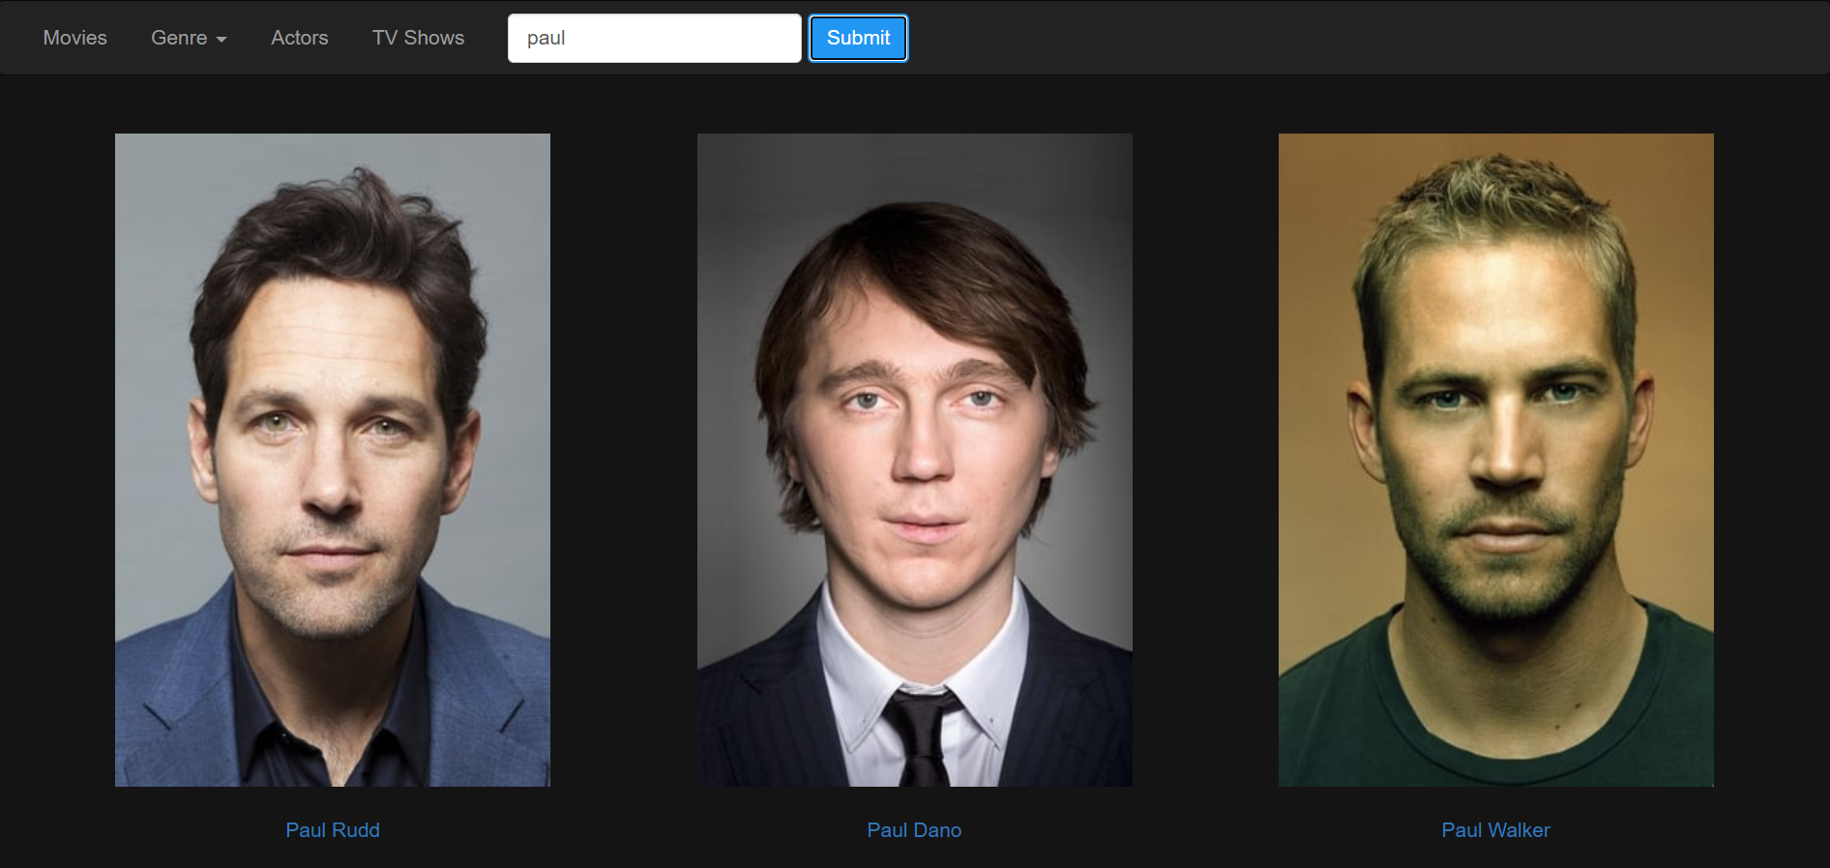

Slide 19
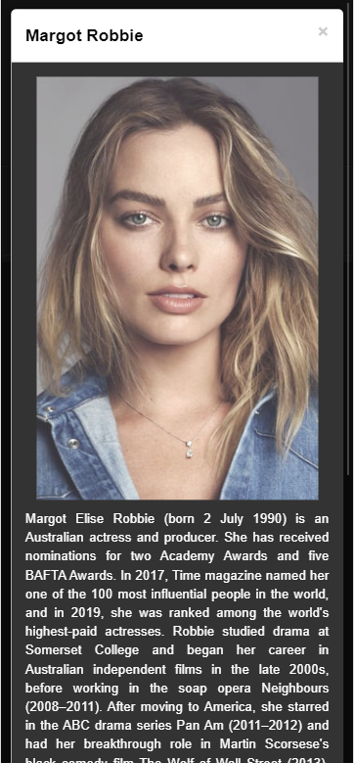
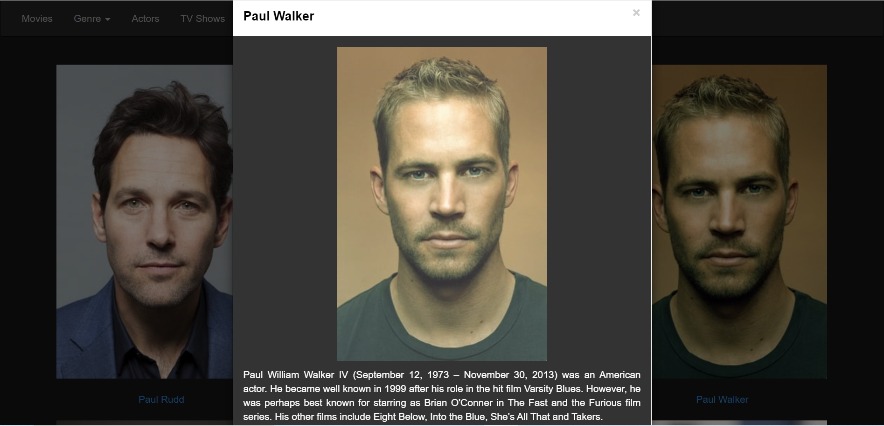

Slide 20
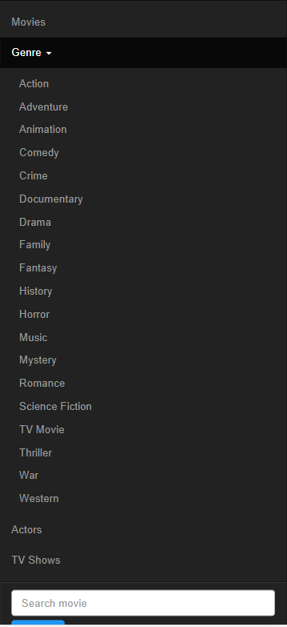
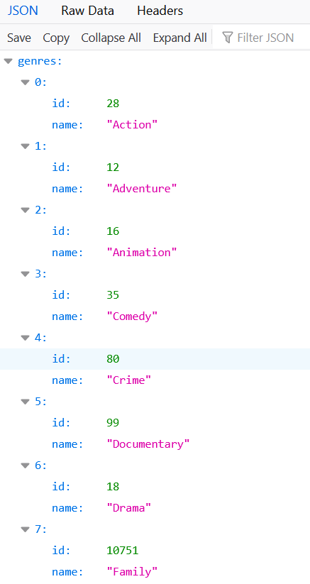
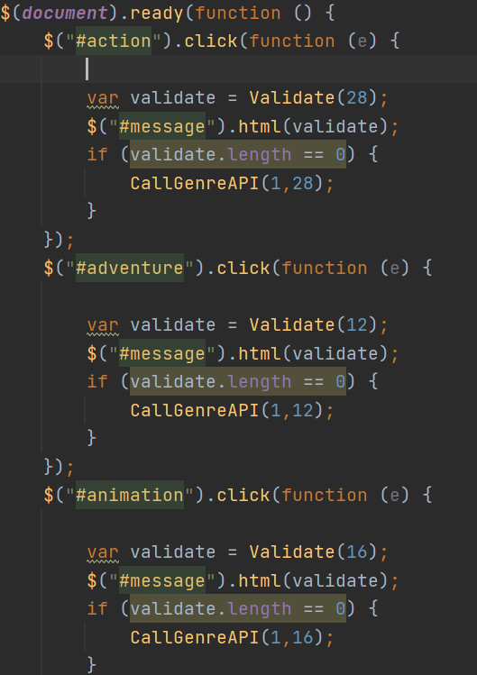
Genre jQuery and Results

Slide 21
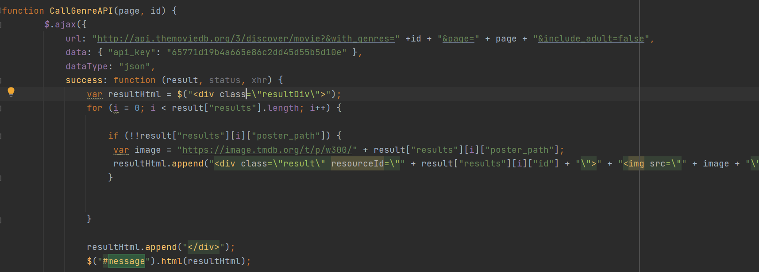
Drop down genre list
Each genre has its own id and it is sent to the CallGenreAPI() function
Only different function between genres.html and movies.html file
With this function movies from a particular genre with their posters are listed
After a movie is selected, it works in the same principle as previously explained

Slide 22
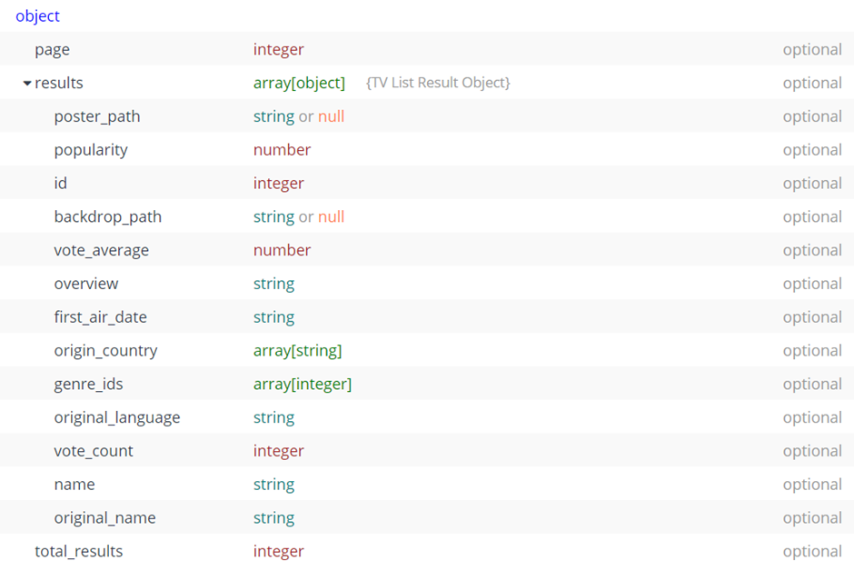
TV Shows jQuery and Results
Works on the same principle as the movies part, only the following changes were made:
URL part(tv instead of movie);
the var release_date with first_air_date;
the var title with name;
the runtime is removed since every episode has different duration;

Slide 23
